Slide 1
🛫 High Cloud Airlines Project 🛫
Presented by: Group 2

Slide 2
Objective: To analyze airline performance across various metrics such as Load Factor, Passenger Distribution, and Carrier Performance using multiple data analytics tools.
Project Overview

Slide 3
Tools Used
Microsoft Excel
Power BI
Tableau
MySQL

Slide 4
Total Records: 110.85K Key Columns: Date, Carrier Name, Transported Passengers, Available Seats, Route, Country, Distance Group Period: 2008–2013
Dataset Summary

Slide 5
Techniques Used:
Formulas: SUMIFS, IFERROR, TEXT, YEAR, MONTH, Ect.
Pivot Tables for:
Yearly Load Factor %
Carrier-wise Load Factor %
Route and Country performance
Load Factor on Weekends vs Weekdays
Created interactive slicers for filtering Origin Country AND YEARMONTH
Excel Analysis
Purpose: Data cleaning, transformation and preliminary KPIs.

Slide 6
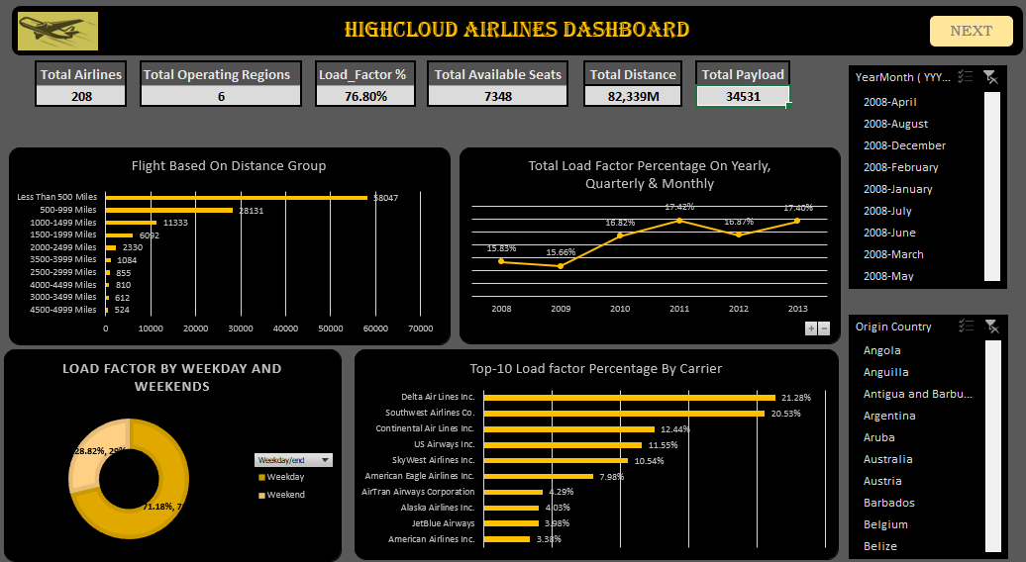
Excel Dashboard
Dashboard - 1

Slide 7
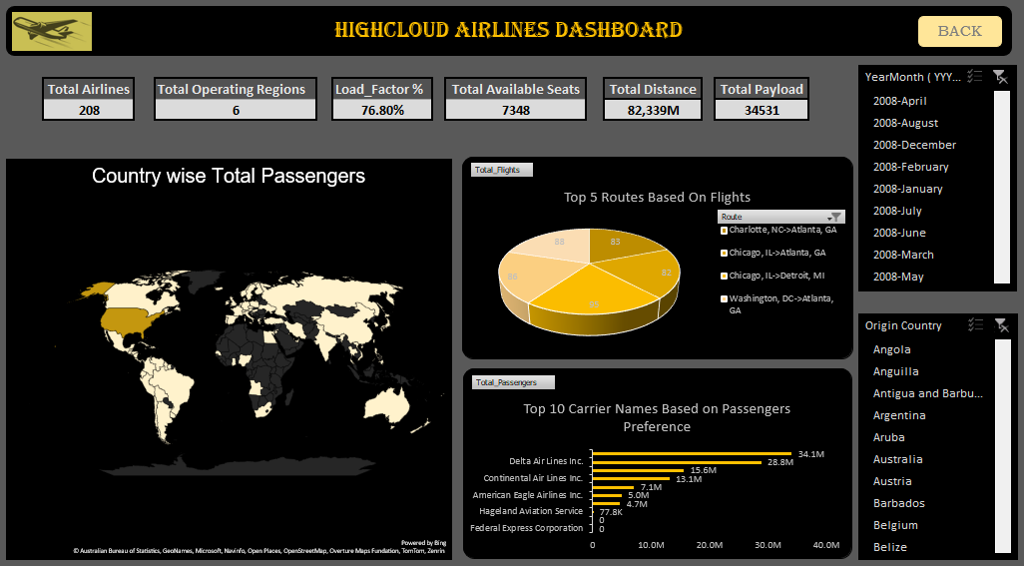
Excel Dashboard
Dashboard - 2

Slide 8
Power BI Analysis
Purpose: Dynamic and visual data modeling and KPI tracking
Steps Done:
Data Modeling using relationships between Date Table, Flight Table AND RESPECTIVE ID’S.
DAX Measures:
Load Factor % = DIVIDE(SUM(TransportedPassengers), SUM(AvailableSeats))
Yearly, Quarterly, Monthly aggregation
Created Hierarchies (Year → Quarter → Month)
KPI Cards, Maps, and Slicers

Slide 9
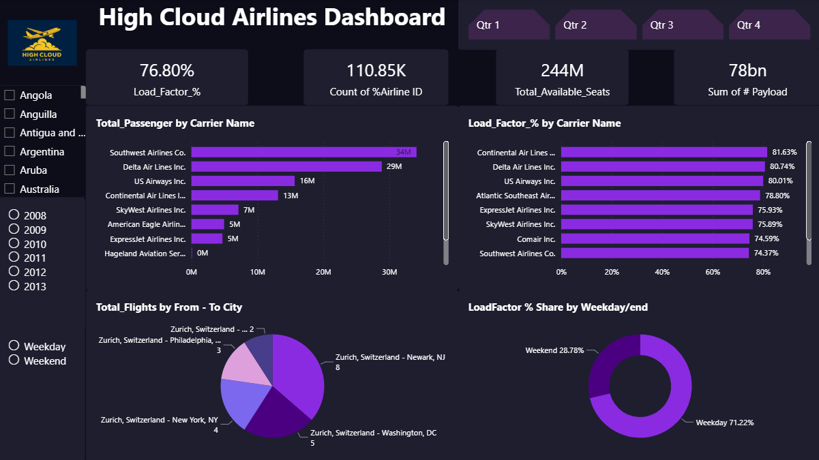
POWERBI Dashboard
Dashboard - 1

Slide 10
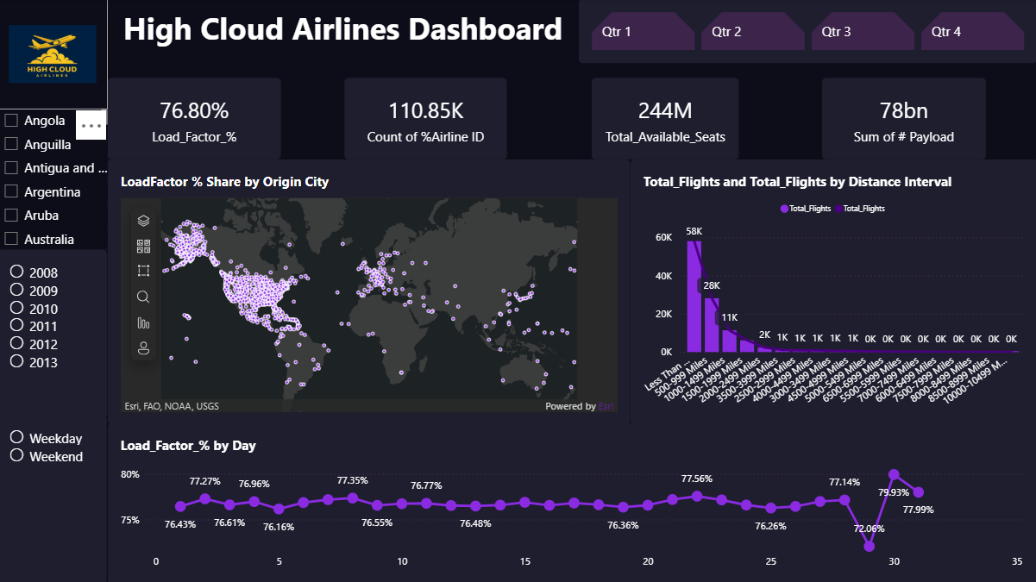
POWERBI Dashboard
Dashboard - 2

Slide 11
Tableau Analysis
Purpose: Visualization and interactive storytelling
Highlights:
Hierarchy created for Year → Quarter → Month
Calculated Field:
Load Factor % = SUM(TransportedPassengers)/SUM(AvailableSeats)
Top 10 Carriers by Passenger Preference (Treemaps)
Top Routes Visualization (Origin → Destination)

Slide 12
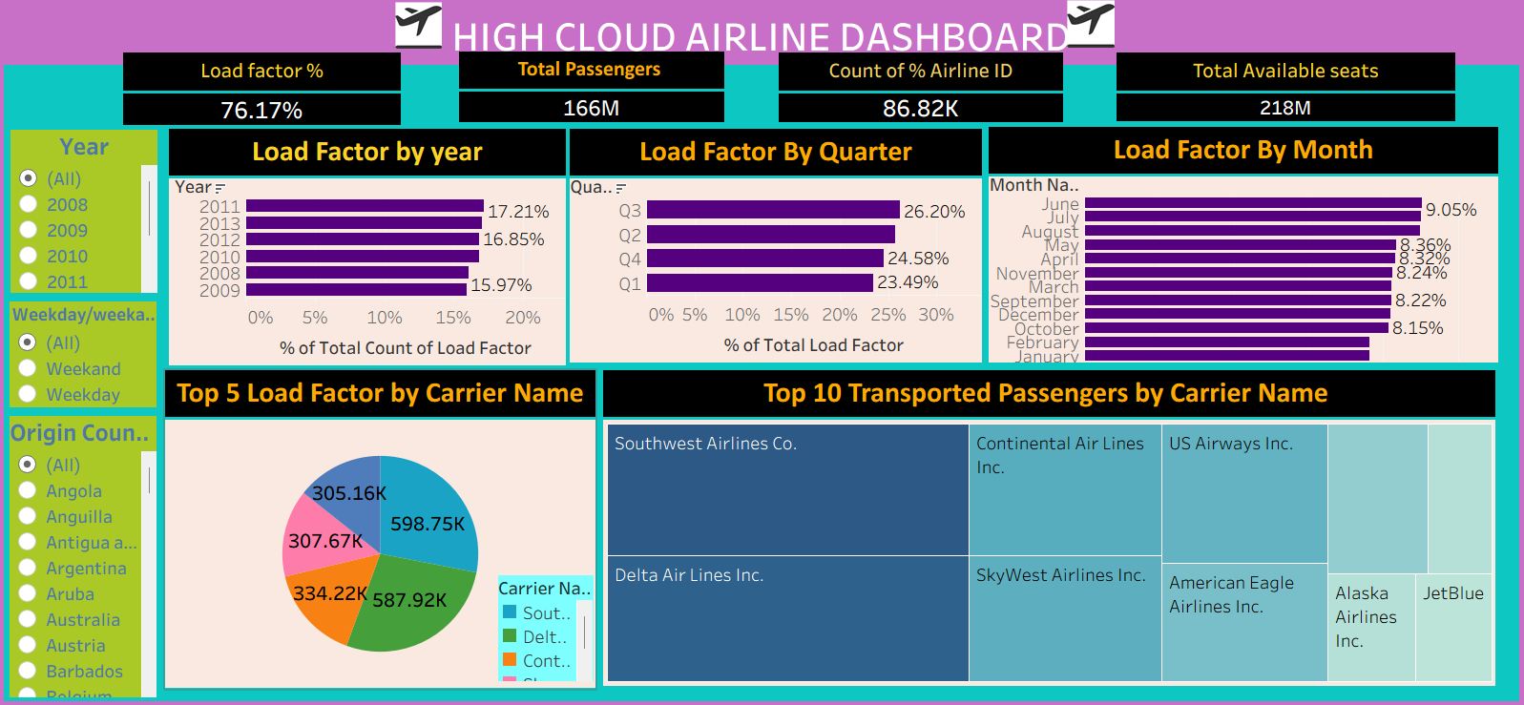
TABLEAU Dashboard
Dashboard - 1

Slide 13
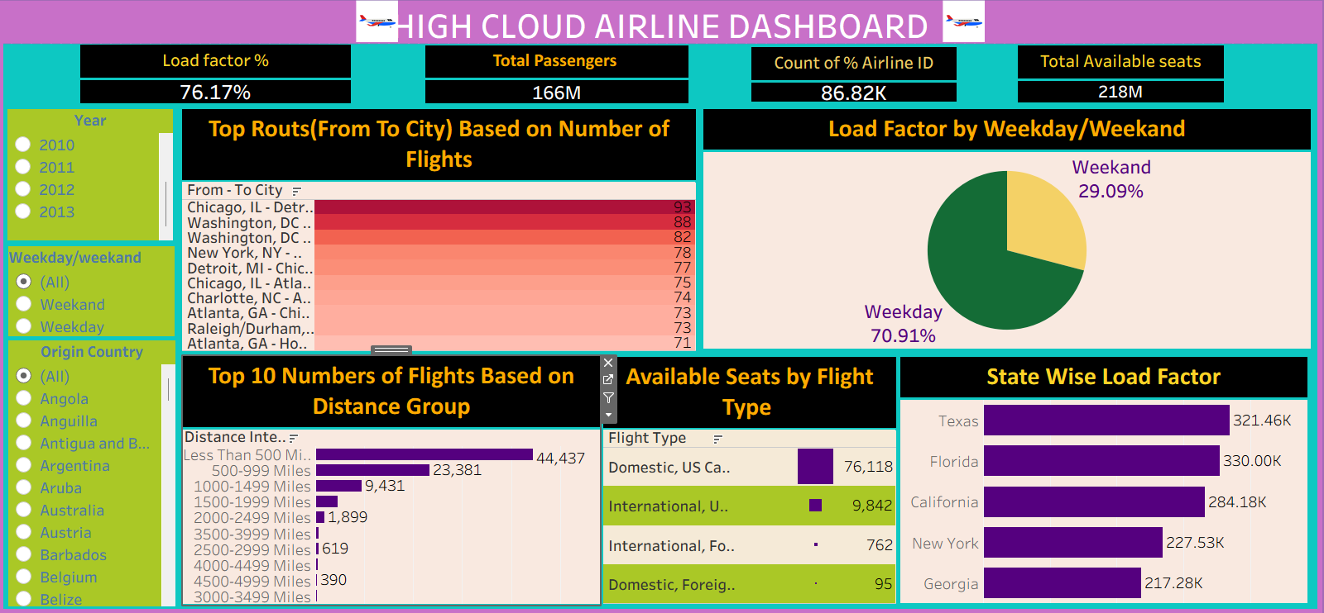
TABLEAU Dashboard
Dashboard - 2

Slide 14
MySQL Analysis
Purpose: Backend data validation and query-based insights
Sample Queries:
SELECT Year, SUM(TransportedPassengers) AS Total_Passengers, SUM(AvailableSeats) AS Total_Seats, (SUM(TransportedPassengers)/SUM(AvailableSeats))*100 AS Load_Factor FROM Flights GROUP BY Year;
Data validation for consistency
Query-based summaries for each carrier and year

Slide 15
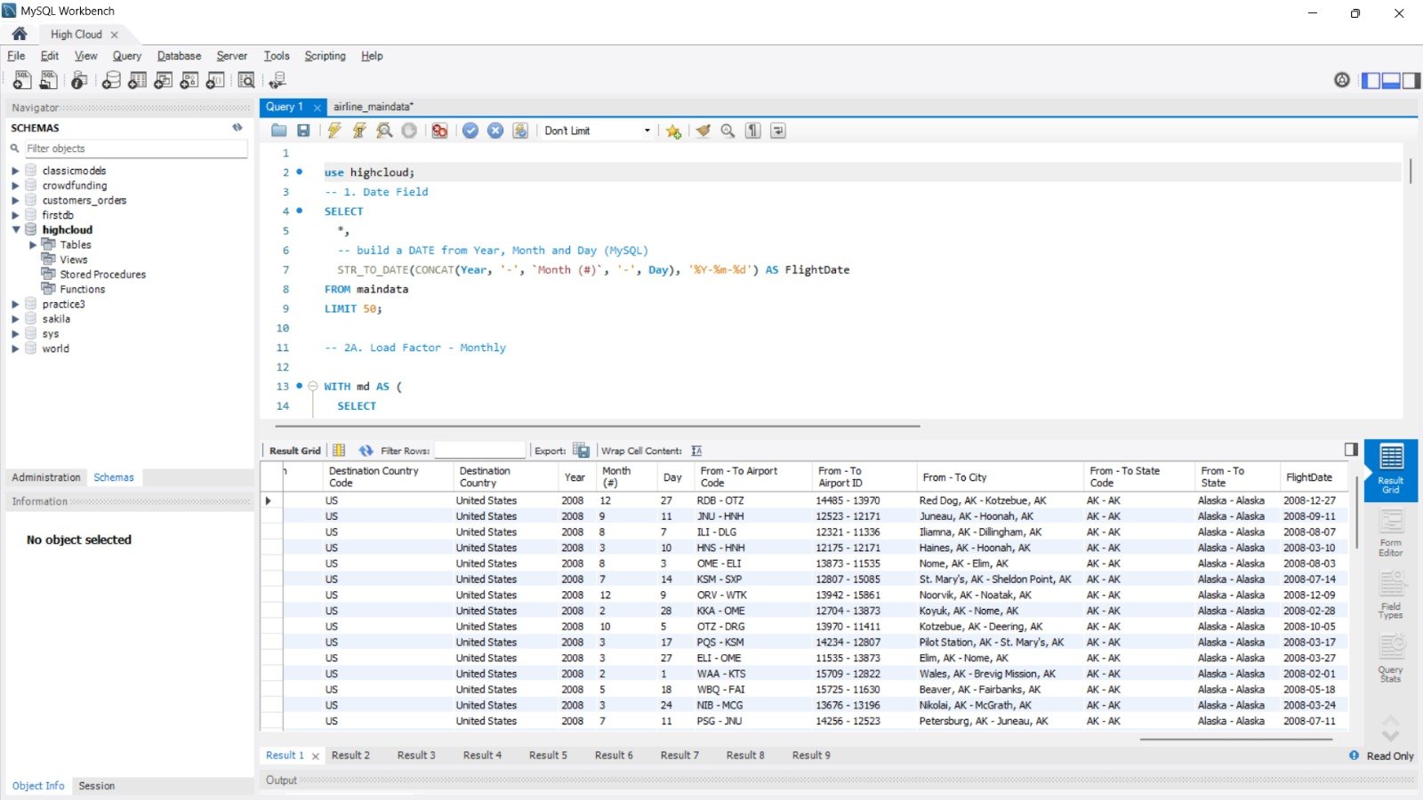
the Year Month (#) Day fields ( First Create a Date Field from Year , Month , Day fields)"

Slide 16
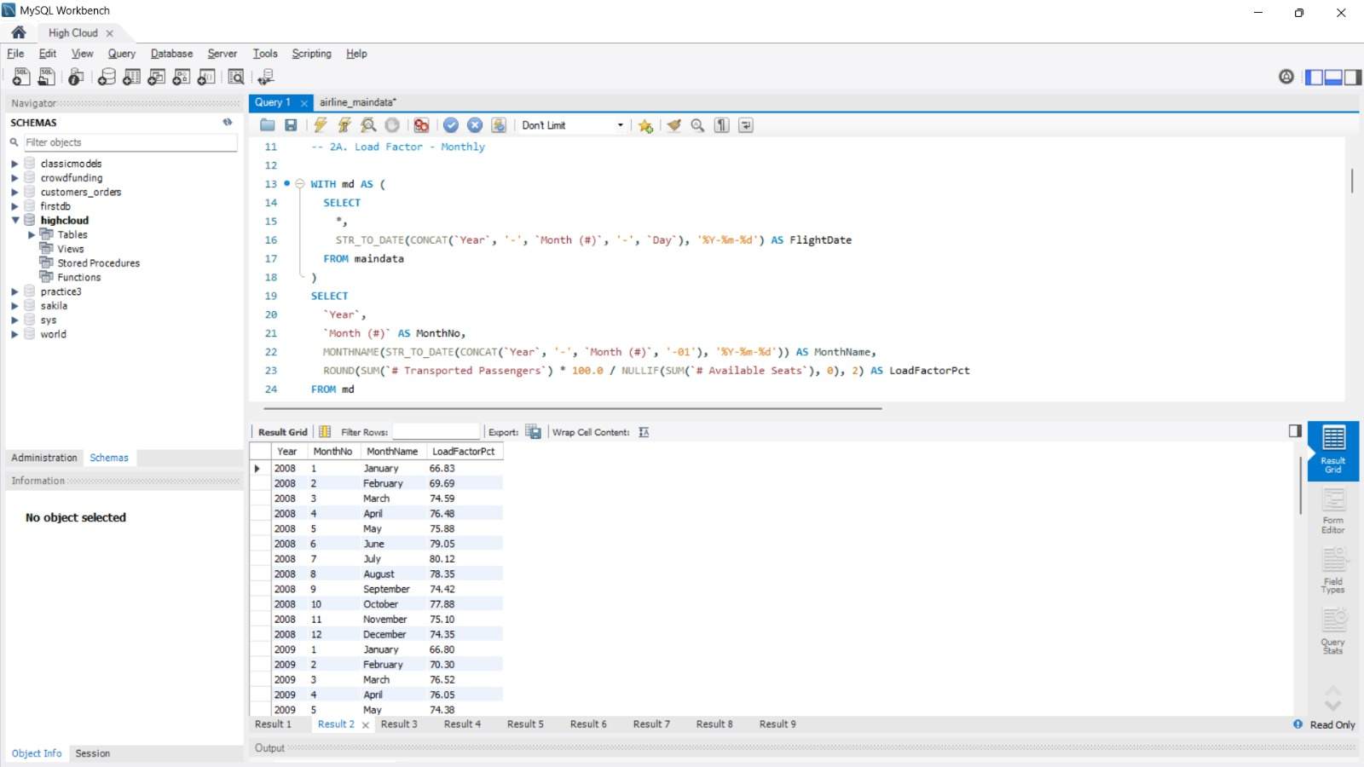
load Factor percentage on a yearly , Quarterly , Monthly basis ( Transported passengers / Available seats) Monthly

Slide 17
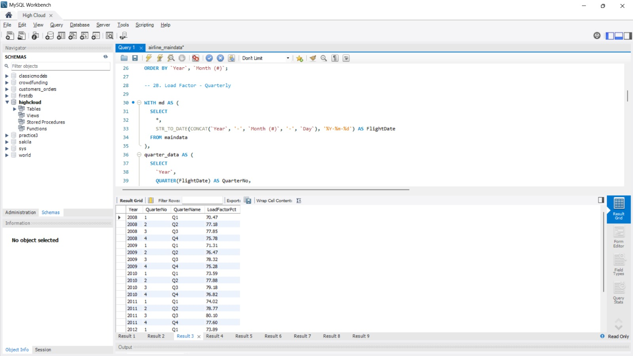
load Factor percentage on a yearly , Quarterly , Monthly basis
(Transported passengers / Available seats) QUARTERLY

Slide 18
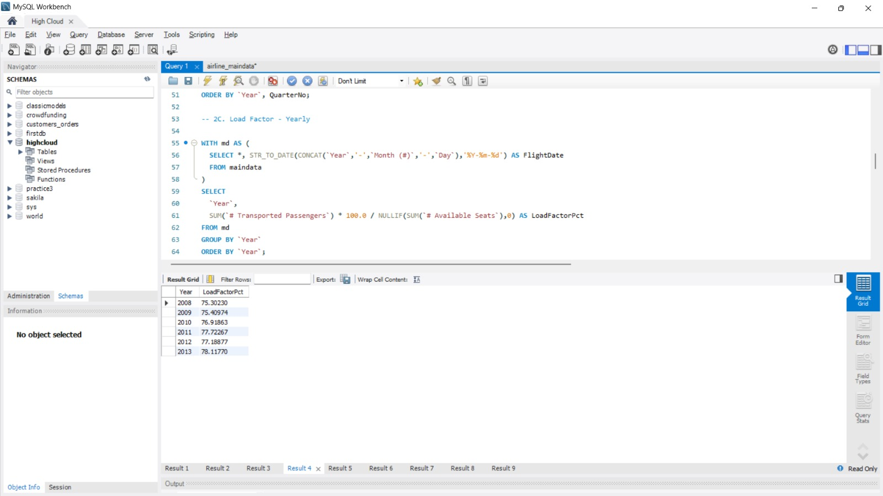
load Factor percentage on a yearly , Quarterly , Monthly basis
(Transported passengers / Available seats) YEARLY

Slide 19
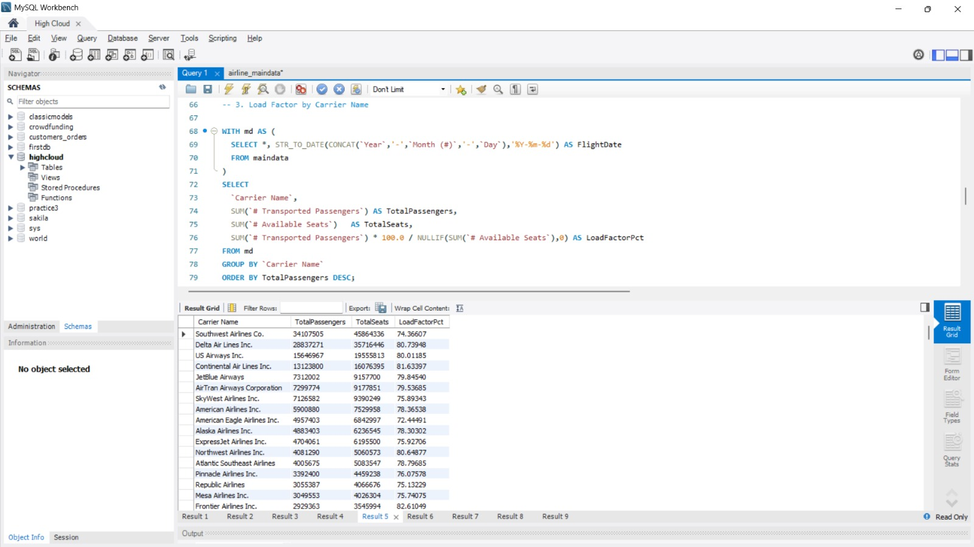
Find the load Factor percentage on a Carrier Name basis ( Transported passengers / Available seats)

Slide 20
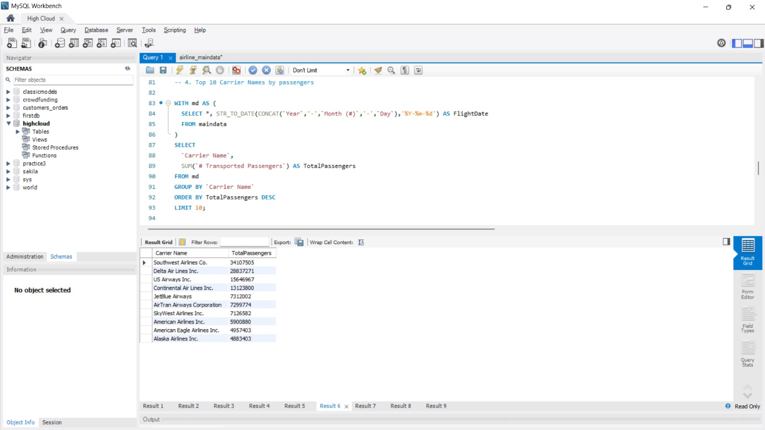
Top 10 Carrier Names based passengers' preference

Slide 21
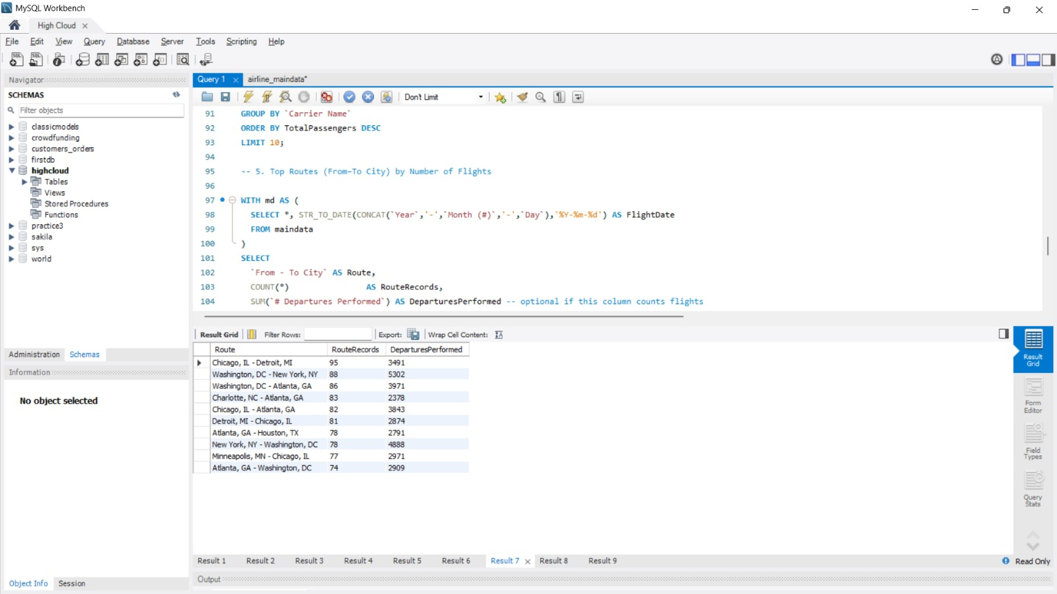
top Routes ( from-to City) based on Number of Flights

Slide 22
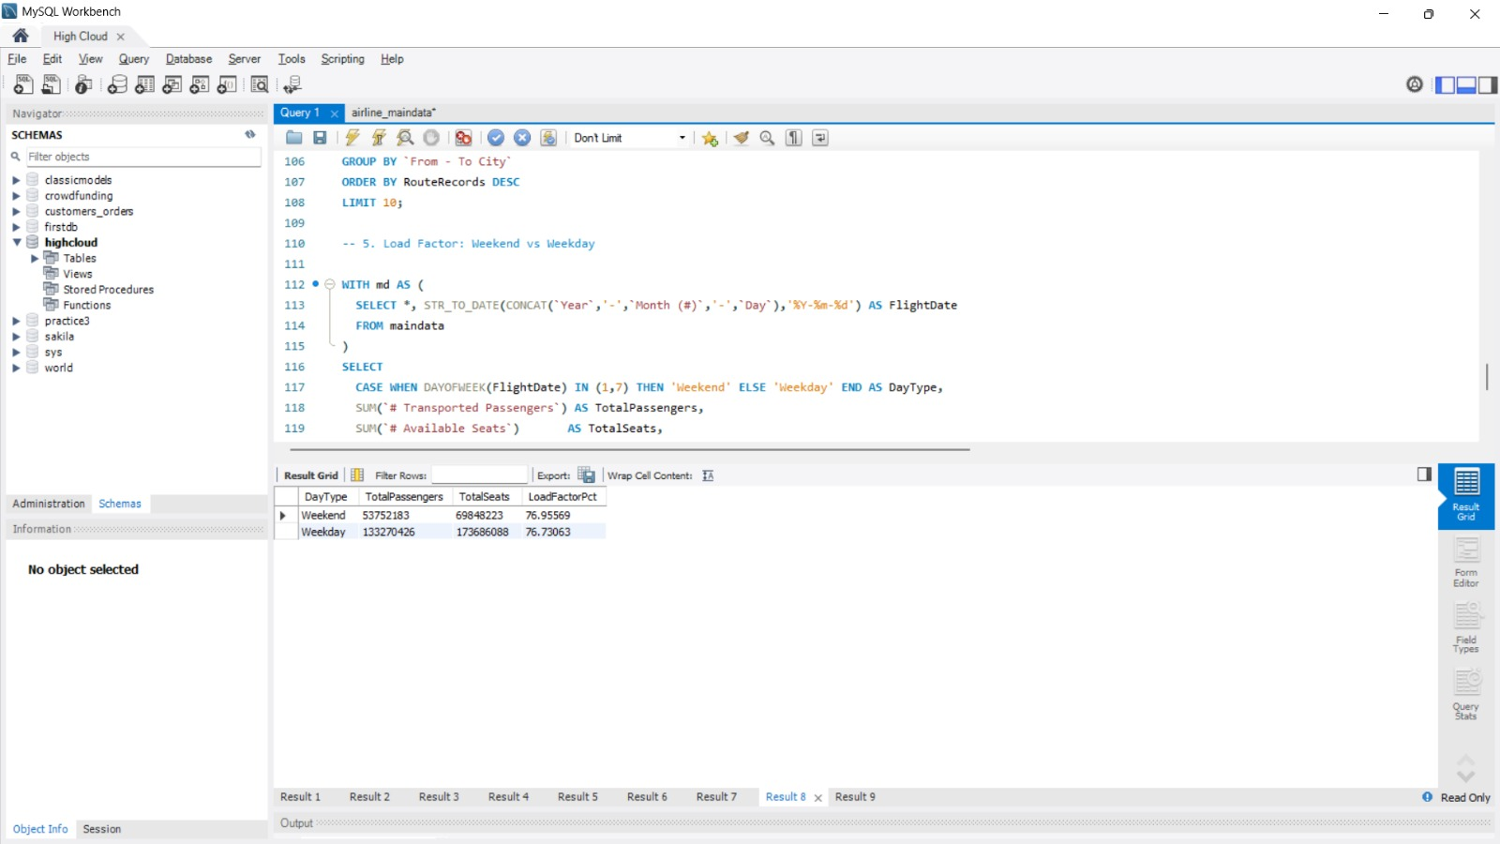
load factor is occupied on Weekend vs Weekdays

Slide 23

number of flights based on Distance group

Slide 24
Key Insights
Highest Load Factor achieved in 2011 with 17.21%
Top Performing Carrier: Southwest Airlines co.
Lowest Performing Route: 47-Mile Mine, AK->Chuathbaluk, AK
Distance Group with highest flight frequency: Less Than 500 Miles

Slide 25
Conclusion
Multi-tool analytics validated the same data through various perspectives.
Excel for base analysis, Power BI for modeling, Tableau for storytelling, MySQL for validation.
High Cloud Airlines can optimize routes and carriers based on Load Factor trends.

Slide 26
THANK YOU
Team Group – 2
ANKITA M KANAKERIMATH
BHARATHI P
GANJEWAR NANDINI ATUL
PRAMOD KUMAR K M PRITISH MISHRA
SHREYASH SANJAY INGOLE
SRIMANTHULA KRANTHI KUMAR

